Slide 1
numpy

Slide 2
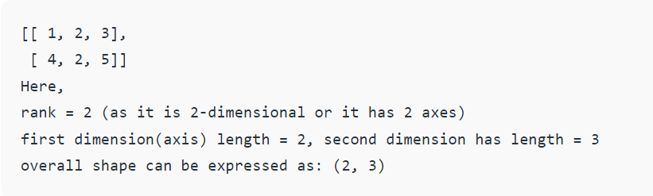
Introduction to numpy
NumPy is a general-purpose array-processing package. It provides a high-performance multidimensional array object, and tools for working with these arrays.
NumPy, which stands for Numerical Python, is a library consisting of multidimensional array objects and a collection of routines for processing those arrays. Using NumPy, mathematical and logical operations on arrays can be performed.
In NumPy dimensions are called axes. The number of axes is rank.
NumPy’s array class is called ndarray. It is also known by the alias array.

Slide 3
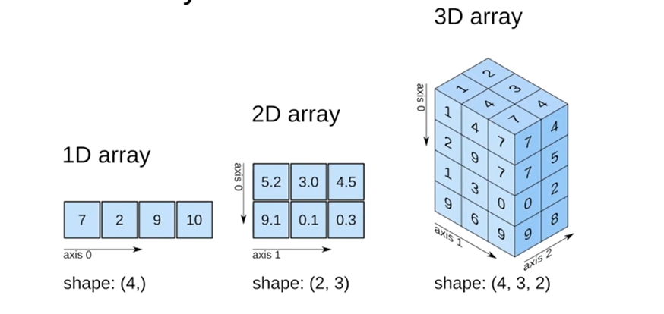
Multi Dimensional Arrays

Slide 4
Advantages over lists
Lists
Numpy Arrays
Slow performance
Occupies more space
Random allocation of memory
Mathematical operations give error
Fast performance
Occupies less space
Continuous allocation of memory
Can do mathematical operations

Slide 5
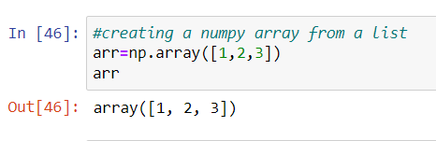
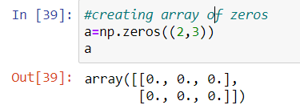
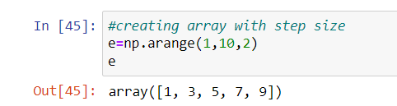
Array creation
List
Tuple
Random
Ones
Zeros
Full
Arange
Linspace
reshape

Slide 6
Inspecting the array
ndarray.ndim - Gives the dimensions of the array
ndarray.shape- Gives the shape of the array
ndarray.dtype –Gives the datatype of the array
ndarray.size – Gives the number of elements in the array

Slide 7
Array indexing and slicing
Knowing the basics of array indexing is important for analysing and manipulating the array object.
a slice object that is of the form start : stop : step
Get a specific element [r,c]
0 | 1 | 2 | 3 | 4 | 5 | 6 | 7 | 8 | 9
a | b | c | d | e | f | g | h | i | j
-10 | -9 | -8 | -7 | -6 | -5 | -4 | -3 | -2 | -1

Slide 8
ARRAY SLICING
a1
b1
c1
d1
e1
a2
b2
c2
d2
e2
a3
b3
c3
d3
e3
a4
b4
c4
d4
e4

Slide 9
Basic operations on array
Addition
Subtraction
Multiplication
Division
Unary operators
Transpose
Sorting of array

Slide 10
Stacking and splitting of arrays
Stacking: Several arrays can be stacked together along different axes.
np.vstack: To stack arrays along vertical axis.
np.hstack: To stack arrays along horizontal axis.
np.column_stack: To stack 1-D arrays as columns into 2-D arrays.
np.concatenate: To stack arrays along specified axis (axis is passed as argument).
Splitting:For splitting, we have these functions:
np.hsplit: Split array along horizontal axis.
np.vsplit: Split array along vertical axis.
np.array_split: Split array along the specified axis.

Slide 11
PANDAS

Slide 12
Introduction to pandas
Pandas is a software library written for the Python programming language for data manipulation and analysis. In particular, it offers data structures and operations for manipulating numerical tables and time series.
Pandas gives you answers about the data. Like:
Is there a correlation between two or more columns?
What is average value?
Max value?
Min value?

Slide 13
Series
Pip install pandas
Import pandas as pd
Pandas Series is a one-dimensional labelled array capable of holding data of any type (integer, string, float, python objects, etc.).
The axis labels are collectively called index.
We can say a column in a excel sheet is a series
We can create series with custom index or default index

Slide 14
Creating a series
Empty series
From an array
From an array along with custom index
From an Index
From a dictionary
From a scalar value
Using inbuilt functions

Slide 15
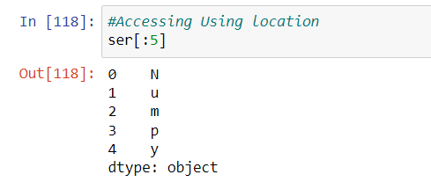
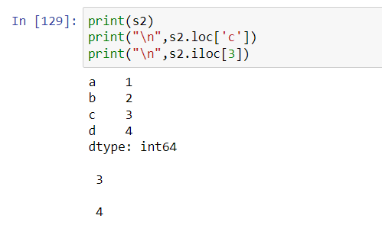
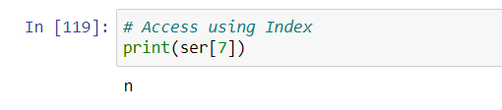
Accessing the series
Just like in lists, we can iterate through series using the index
Using iloc() and loc()

Slide 16
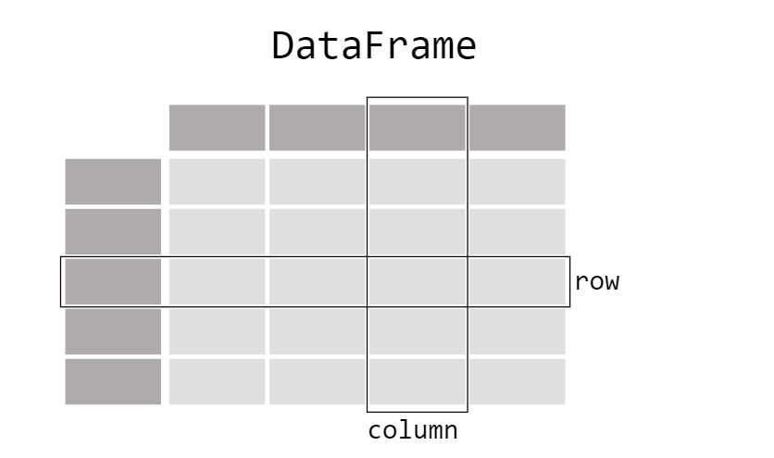
Pandas data table representation
Dataframe consists of rows and columns
A DataFrame is a 2-dimensional data structure that can store data of different types (including characters, integers, floating-point values, categorical data, and more) in columns. It is similar to a spreadsheet, a SQL table
Each column of the dataframe is a Series

Slide 17
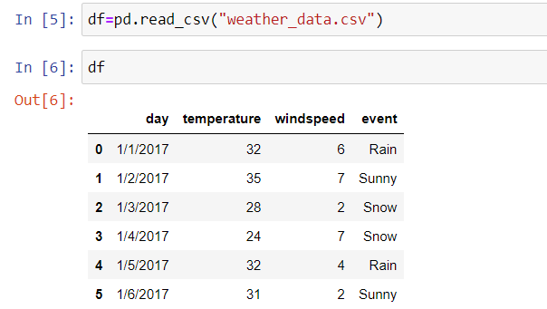
Creating a DATAFRAME
From a dictionary
From a list
List of dictionaries
From a csv file using df=pd.read_csv("weather_data.csv")
From a excel sheet using df=pd.read_excel(“stocks_data.xslx”)

Slide 18
DataFrame Functions
df.head() gets the first 5 rows by default
df.tail() gets the last 5 rows by default
df.describe() provides descriptive statistics of all numerical columns
df.unique() provides the number of unique items in a column
df.sort_values() sorts the dataframe by specific column
df.info() gives the details about the dataframe like number of null values, datatypes,..
df.shape gives the number of rows and columns in the dataframe
df.to_string() gives the whole dataframe as string
Df.set_index() will set the index

Slide 19
DataFrame Column Functions
.info() provides an overview of all the columns, number of non-nulls, and data types in a DataFrame
.max() gets the max value from a column
.min() gets the min value from a column
.mean() get the mean value from a column
.idxmax() gets the integer index position of the max value from a column
.idxmin() gets the integer index position of the min value from a column
.loc() gets rows (or columns) with particular labels from the index
.iloc() gets rows (or columns) with particular positions in the index (only takes integers)
.columns gets the list of names of columns

Slide 20



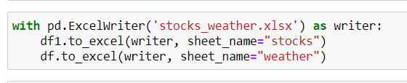

Reading and writing to and from csv or excel
Using header attribute
Using skiprows attribute
using nrows attribute
Replacing invalid values with null before reading
Replacing values for a specific column

Slide 21
Null values in pandas
Pandas primarily uses the value np.nan to represent missing data. It is by default not included in computations.
To make detecting missing values easier (and across different array dtypes), pandas provides the isna() and notna() functions, which are also methods on Series and DataFrame objects
Dropna() is used to drop all the rows with null values
fillna() can “fill in” NA values with non-NA data
Ffill() to fill data in forward direction
Bfill() to fill data in backward direction

Slide 22
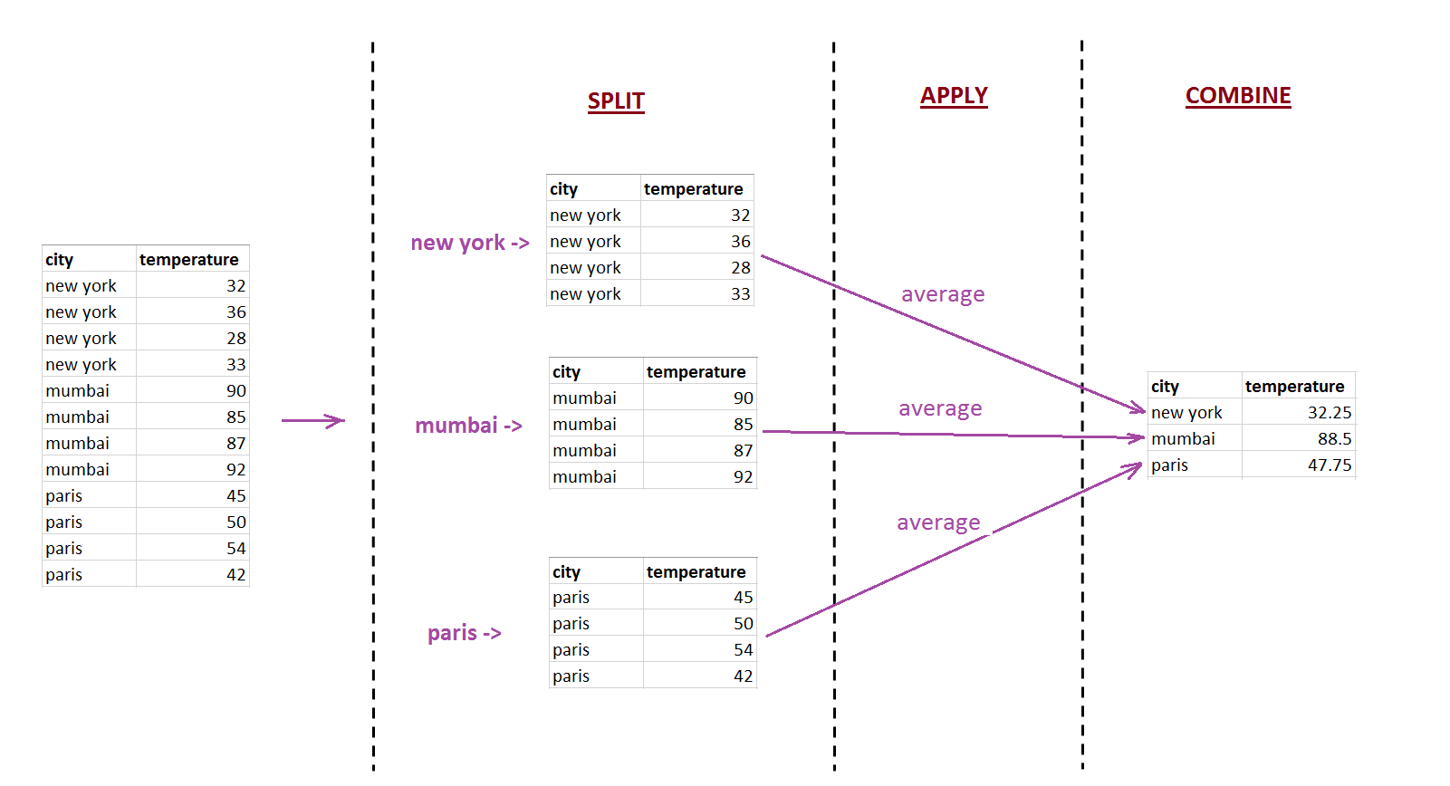
Group by function
It follows Split , Apply,Combine

